Slide 1
Create Maven Project
Simplified project building with Maven

Slide 2
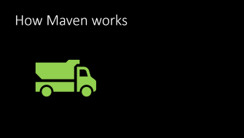

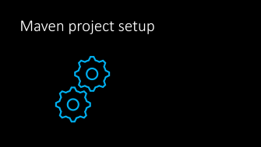
What's coming…

Slide 3

All about Apache Maven

Slide 4
What is Apache Maven?
Maven is an application build tool
Builds
Tests
Packages

Slide 5
How are we using Maven?
We use Maven to add project dependencies
A dependency is a Java library that contains code used by our application
Java libraries are packaged as Java ARchives (JAR files)
JAR files are ZIP files with a specific directory structure
The Java Runtime knows how to read JAR files and find code and resources in them

Slide 6
What dependencies do we need?
MySQL Connector/J
This is a database driver

Slide 7
Database driver
A database driver supports the Java Database Connectivity (JDBC) standard
A driver is used to…
Manage connections
Send SQL to a database
Manage results from the database in a consistent manner
A driver is specific to a particular database
Drivers are (normally) maintained by the teams that write the database

Slide 8



The driver connects the database and client
Driver
Schema
Data
Database
Client

Slide 9


How Maven works

Slide 10
The Project Object Model
The Project Object Model (POM) controls the build
The POM is described in an XML file: pom.xml
Eclipse has an internal version of Maven and a Maven connector (m2e)
Any changes made to the POM file are reflected in Eclipse
Any dependencies added in the POM are added to the application runtime

Slide 11
The bottom line
We can add the MySQL driver as a dependency in the POM
The Maven-Eclipse connector tells Eclipse to add the driver to the application runtime
We then write Java code with JDBC-compliant classes
The Java classes load and talk to the driver in a consistent manner
The driver talks to the database
Bottom line: we can write Java code to talk to the database – our application becomes a database client

Slide 12
How to add a project dependency
<dependencies>
<dependency>
<groupId>mysql</groupId>
<artifactId>mysql-connector-java</artifactId>
<version>8.0.27</version>
</dependency>
</dependencies>

Slide 13
How to find a dependency?
Navigate to https://mvnrepository.com/
Type "mysql" in the search box
Click on the link for MySQL Connector/J
Click on the link for the latest version
Make sure the "Maven" tab is selected
Click in the dependency box
Paste into pom.xml

Slide 14

Maven project setup

Slide 15
Important directories
Source code: src/main/java
Project resources: src/main/resources
Built class files: target/classes

Slide 16
Watch the project grow!
Create the Maven project
Add the driver dependency
Set the compiler version in the project

